Slide 1


Fast Direction-Aware Proximity for Graph Mining
Speaker: Hanghang Tong
Joint work w/ Yehuda Koren, Christos Faloutsos

Slide 2
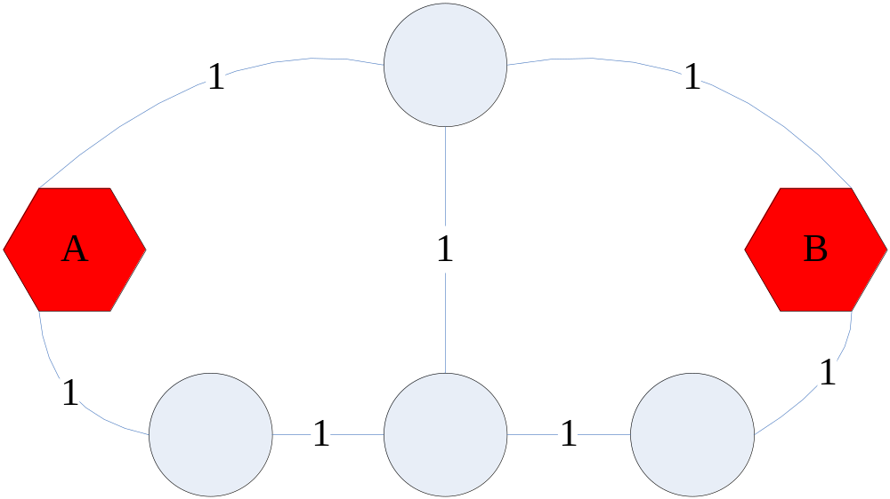
Proximity on Graph
Un-directed graph
  What is Prox between A and B
  ‘how close is Smith to Johnson’?
But, many real graphs are directed….

Slide 3
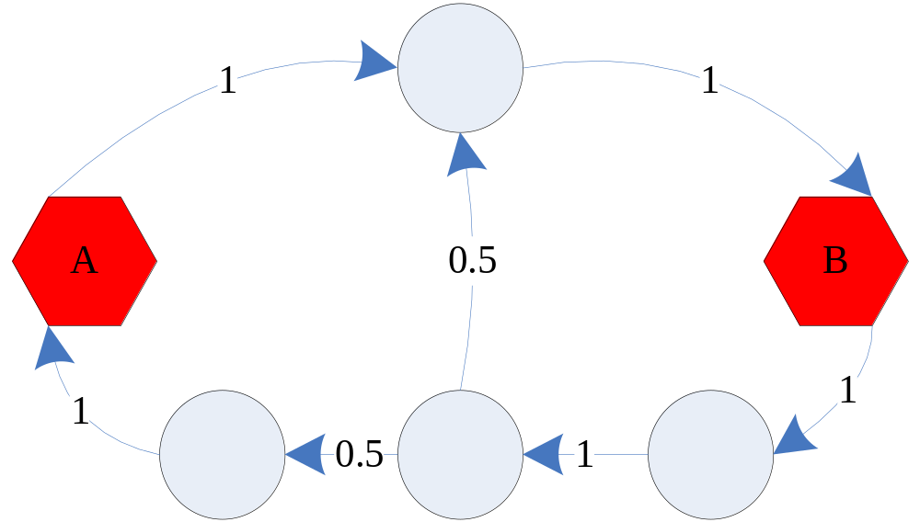
Edge Direction w/ Proximity
  What is Prox from A to B?
  What is Prox from B to A?

Slide 4
Motivating Questions (Fast DAP)
Q1: How to define it?
Q2: How to compute it efficiently?
Q3: How to benefit real applications?
Notes:
In this talk, we will try to answer the following three questions:
How to compute this direction-sensitive proximity (abbreviated as DSP)?
How to compute it efficiently?
And does it provide useful information for real applications?
I will focus on those main concepts, the basic idea and the intuition behind our methods, rather than the algorithm details.

Slide 5
Roadmap
DAP definitions
  Escape Probability
  Issue # 1: ‘degree-1 node’ effect
  Issue # 2: weakly connected pair
Computational Issues
  FastAllDAP: ALL pairs
  FastOneDAP: One pair
Experimental Results
Conclusion
Notes:
Here is the road map

Slide 6


Defining DAP: escape probability
Define Random Walk (RW) on the graph
Esc_Prob(A→B)
  Prob (starting at A, reaches B before returning to A)
the remaining
graph
A
B
Esc_Prob = Pr (smile before cry)

Slide 7
Esc_Prob: Example
Esc_Prob(a->b)=1 > Esc_Prob(b->a)=0.5

Slide 8
Esc_Prob is good, but…
Issue #1:
  `Degree-1 node’ effect
Issue #2:
  Weakly connected pair
Need some practical modifications!

Slide 9
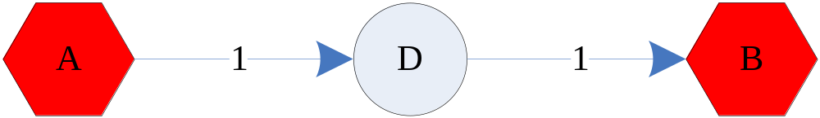
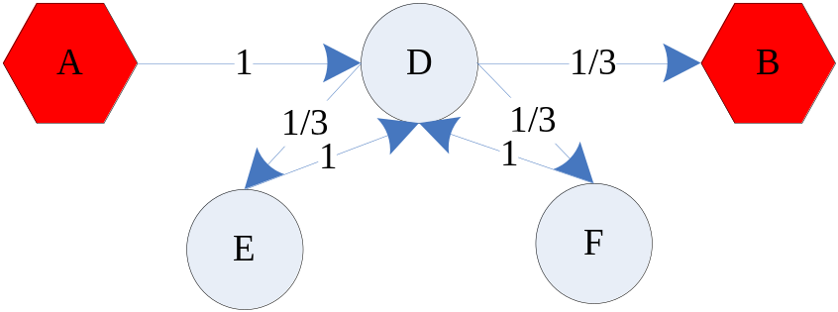
Issue#1: `degree-1 node’ effect
[Faloutsos+] [Koren+]
Esc_Prob(a->b)=1
Esc_Prob(a->b)=1
no influence for degree-1 nodes (E, F)!
  known as ‘pizza delivery guy’ problem in undirected graph
Solutions: Universal Absorbing Boundary!

Slide 10
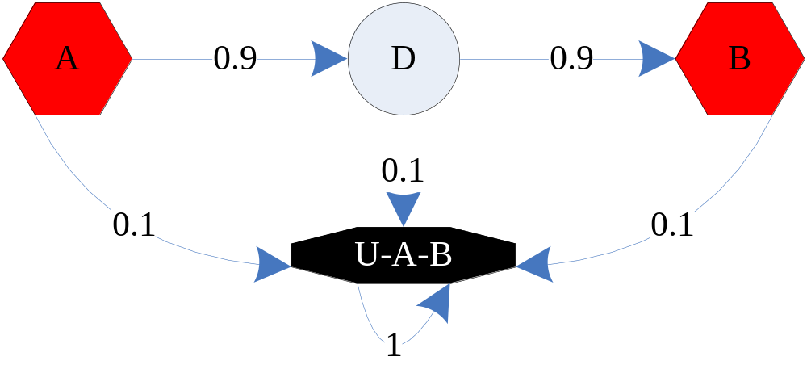

Universal Absorbing Boundary
Footnote: fly-out probability = 0.1
U-A-B is a black-hole!

Slide 11
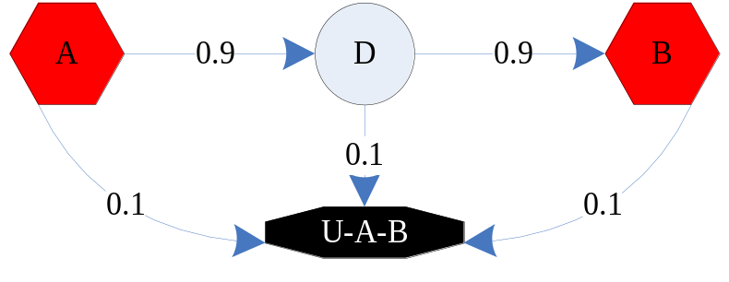
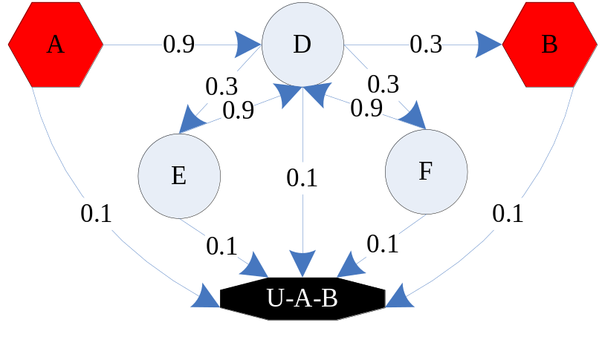
Introducing Universal-Absorbing-Boundary
Esc_Prob(a->b)=1
Prox(a->b)=0.91
Esc_Prob(a->b)=1
Prox(a->b)=0.74
Footnote: fly-out probability = 0.1

Slide 12
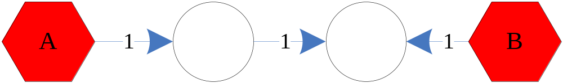
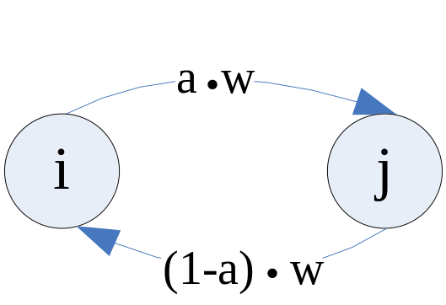
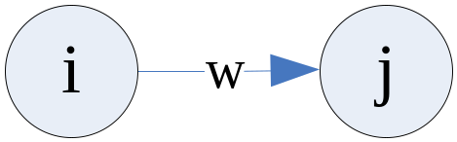
Issue#2: Weakly connected pair
Prox(A→B) = Prox (B→A)=0
Solution: Partial symmetry!

Slide 13
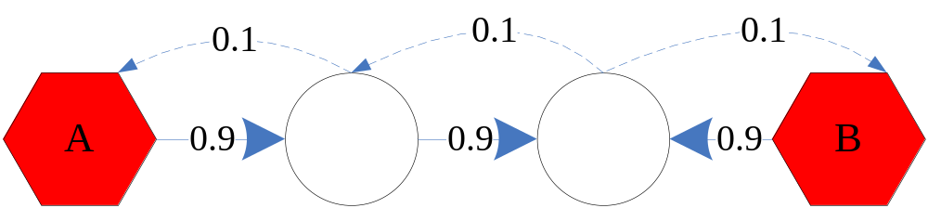
Practical Modifications: Partial Symmetry
Prox(A→B) = Prox (B→A)=0
Prox(A→B) =0.081 > Prox (B→A)=0.009

Slide 14
Roadmap
DAP definitions
  Escape Probability
  Issue # 1: ‘degree-1 node’ effect
  Issue # 2: weakly connected pair
Computational Issues
  FastAllDAP: ALL pairs
  FastOneDAP: One pair
Experimental Results
Conclusion
Notes:
Here is the road map

Slide 15
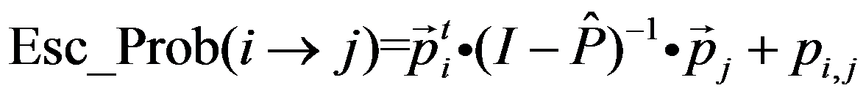
Solving Esc_Prob: [Doyle+]
P: transition matrix (row norm.)
n: # of nodes in the graph
1 x (n-2)
(n-2) x (n-2)
1 x (n-2)
i^th row → removing
i^th & j^th elements
P → removing i^th
& j^th rows & cols
i^th col → removing
i^th & j^th elements
One matrix inversion , one Esc_Prob!

Slide 16
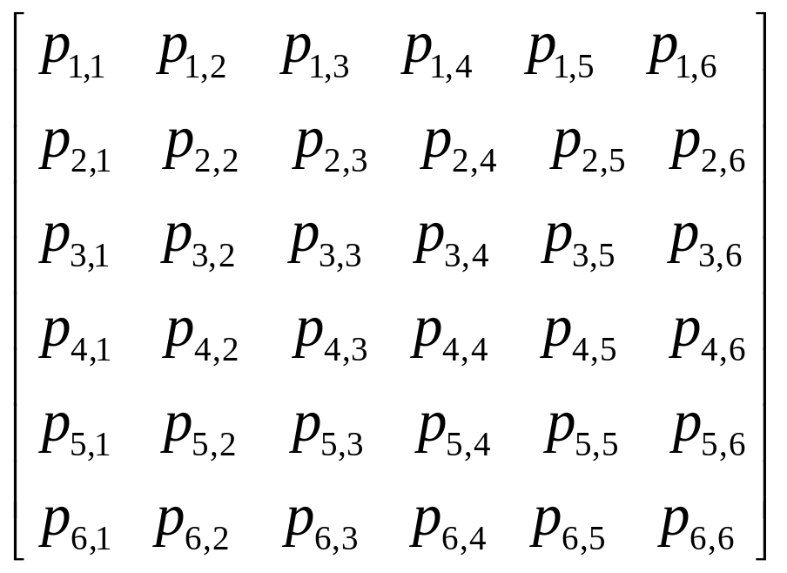



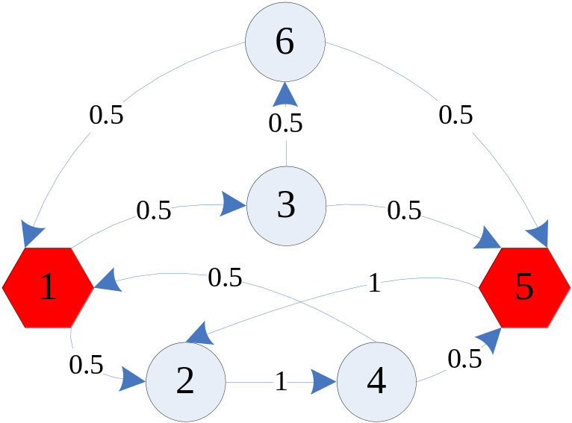
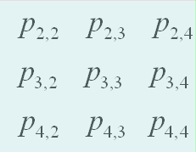





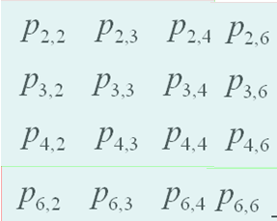


P=
P: Transition matrix (row norm.)
-1
Esc_Prob(1->5)
=
I -
+

Slide 17
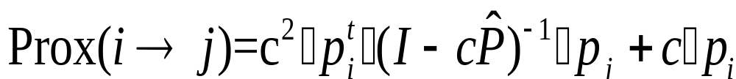
Solving DAP (Straight-forward way)
1-c: fly-out probability (to black-hole)
1 x (n-2)
(n-2) x (n-2)
1 x (n-2)
One matrix inversion, one proximity!

Slide 18
Challenges
Case 1, Medium Size Graph
  Matrix inversion is feasible, but…
  What if we want many proximities?
  Q: How to get all (n ) proximities efficiently?
  A: FastAllDAP!
Case 2: Large Size Graph
  Matrix inversion is infeasible
  Q: How to get one proximity efficiently?
  A: FastOneDAP!
2
Notes:
The matrix inversion in solving dap brings the following computational challenges:
For a median size graph, say with several thousand nodes, the matrix inversion is feasible. However, by the formula, it requires a different matrix inversion for a different proximity. So, if we want to compute a lot of proximities, we need to do a lot of matrix inversions, which is not efficient even for median size graphs. So, in this case, how can we reduce the number of matrix inversion?
On the other hand, for a large, say with hundreds of thousands of nodes, matrix inversion would be very slow if not impossible. So, in this case, how can we avoid matrix inversion completely to compute one proximity.

Slide 19
FastAllDAP
Q1: How to efficiently compute all possible proximities on a medium size graph?
  a.k.a. how to efficiently solve multiple linear systems simultaneously?
Goal: reduce # of matrix inversions!

Slide 20
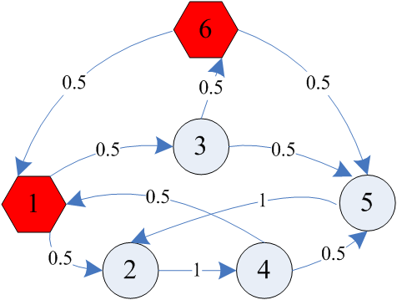
FastAllDAP: Observation
P=
P=
Need two different matrix inversions!

Slide 21
FastAllDAP: Rescue
Prox(1 → 5)
P=
Prox(1 → 6)
Overlap between
two gray parts!
P=
Redundancy among different linear systems!

Slide 22
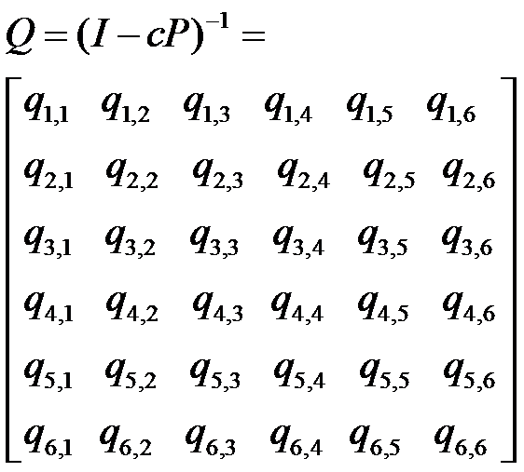
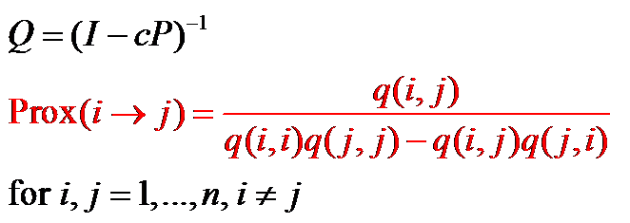
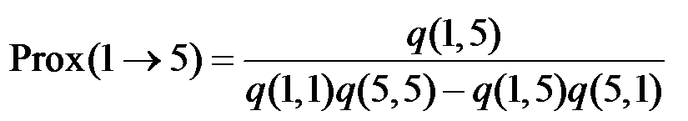
FastAllDAP: Theorem
Theorem:
Proof: by SM Lemma
Example:

Slide 23
FastAllDAP: Algorithm
Alg.
  Compute Q
  For i,j =1,…, n, compute
Computational Save O(1) instead of O(n )!
Example
  w/ 1000 nodes,
  1m matrix inversion vs. 1 matrix!
2

Slide 24
FastOneDAP
Q1: How to efficiently compute one single proximity on a large size graph?
  a.k.a. how to solve one linear system efficiently?
Goal: avoid matrix inversion!

Slide 25
FastOneDAP: Observation
Partial Info. (4 elements /2 cols ) of Q is enough!

Slide 26

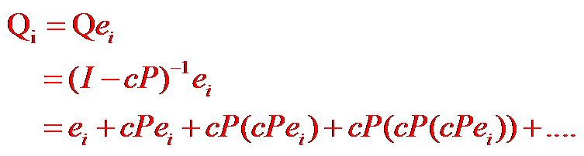

FastOneDAP: Observation
Q: How to compute one column of Q?
A: Taylor expansion
T
[0, …0, 1, 0, …, 0]
th
i col of Q
Reminder:

Slide 27
FastOneDAP: Observation
T
[0, …0, 1, 0, …, 0]
th
i col of Q
….
x
x
x
Sparse matrix-vector multiplications!

Slide 28
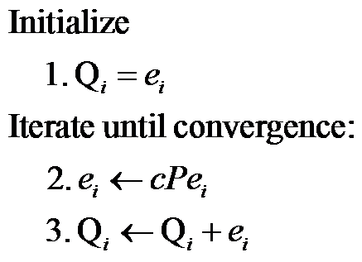
FastOneDAP: Iterative Alg.
th
Alg. to estimate i Col of Q

Slide 29
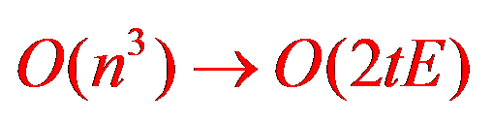
FastOneDAP: Property
Convergence Guaranteed !
Computational Save
  Example:
    100K nodes and 1M edges (50 Iterations)
    10,000,000x fast!
Footnote: 1 col is enough!
  (details in paper)

Slide 30
Roadmap
DAP definitions
  Escape Probability
  Issue # 1: ‘degree-1 node’ effect
  Issue # 2: weakly connected pair
Computational Issues
  FastAllDAP: ALL pairs
  FastOneDAP: One pair
Experimental Results
Conclusion
Notes:
Here is the road map

Slide 31
Datasets (all real)
Name | Node # | Edge # | Directionality
WL | 4k | 10k | A-links to-B
PC | 36k | 64k | Who-contact-whom
EP | 76k | 509k | Who-trust-whom
CN | 28k | 353k | A-cites-B
AE | 38k | 115k | Who-email to-whom
Notes:
Now we will show some experimental results to
We use five datasets and all of them are directed, such as web-link graph, who-trust-whom, who-emails-to whom and so on.

Slide 32
We want to check…
Effectiveness
  Link Prediction
    Existence
    Direction
Efficiency
  FastAllDAP
  FastOneDAP
Notes:
We want to check both the effectiveness and efficiency of our DAP.

Slide 33
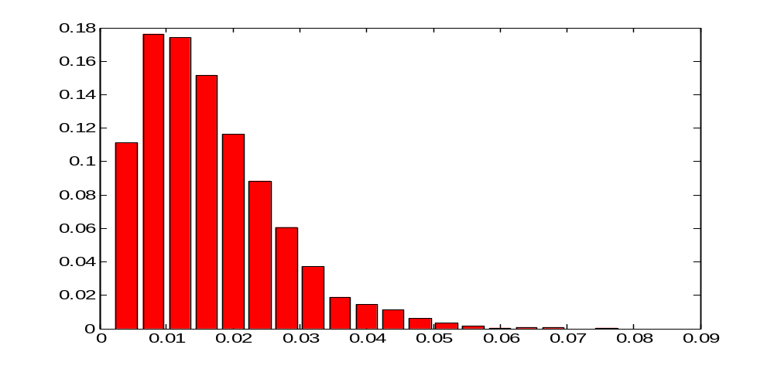
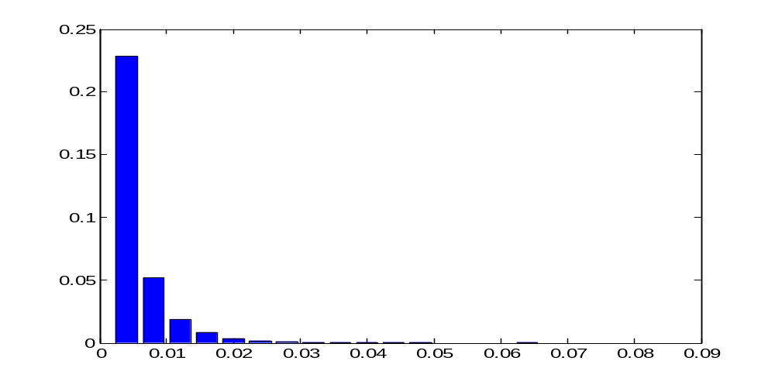
Link Prediction: existence
density
with link
Prox (i→j)+Prox (j→i)
DAP is effective to distinguish red and blue!
density
no link
Prox (i→j)+Prox (j→i)

Slide 34
Link Prediction: existence
Dataset | Accuracy
 | DAP | UDAP
WL | 65.40% | 65.40%
PC | 79.60% | 80.78%
AE | 81.51% | 80.60%
CN | 86.71% | 84.00%
EP | 92.21% | 92.09%

Slide 35
Link Prediction: existence
Dataset | Accuracy
WL | 65.40%
PC | 79.60%
AE | 81.51%
CN | 86.71%
EP | 92.21%

Slide 36
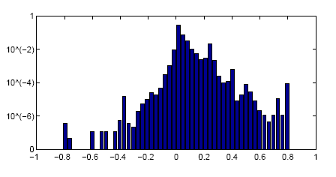
Link Prediction: direction
Q: Given the existence of the link, what is the direction of the link?
A: Compare prox(i→j) and prox(j→i)
>70%
density
Prox (i→j) - Prox (j→i)

Slide 37
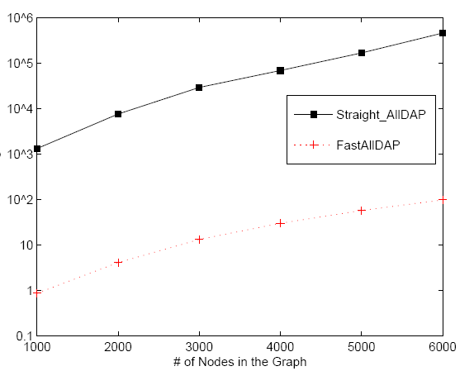
Efficiency: FastAllDAP
Time (sec)
Straight-Solver
1,000x
faster!
FastAllDAP
Size of Graph

Slide 38
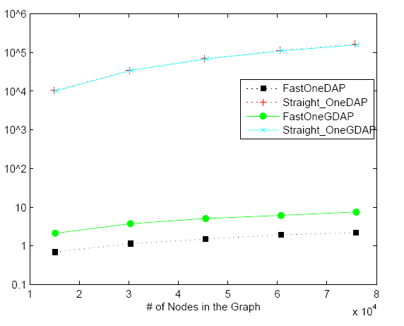
Efficiency: FastOneDAP
Time (sec)
Straight-Solver
1,0000x
faster!
FastOneDAP
Size of Graph
Notes:
Similar observation for computing one single proximity

Slide 39
Roadmap
DAP definitions
  Escape Probability
  Issue # 1: ‘degree-1 node’ effect
  Issue # 2: weakly connected pair
Computational Issues
  FastAllDAP: ALL pairs
  FastOneDAP: One pair
Experimental Results
Conclusion
Notes:
Here is the road map

Slide 40
Conclusion (Fast DAP)
Q1: How to define it?
A1: Esc_Prob + Practical Modifications
Q2: How to compute it efficiently?
A2: FastAllDAP & FastOneDAP
  (100x – 10,000x faster!)
Q3: How to benefit real applications?
A3: Link Prediction (existence & direction)

Slide 41
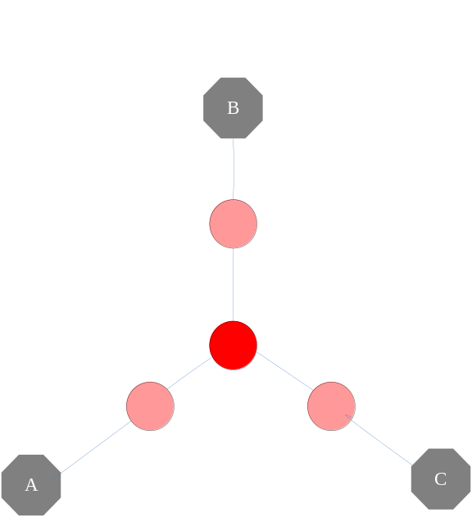
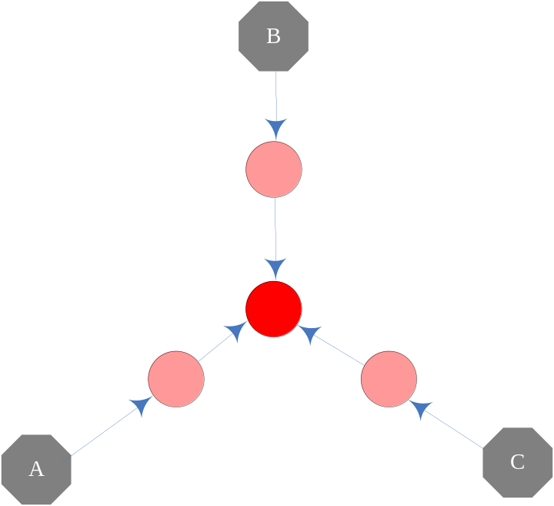
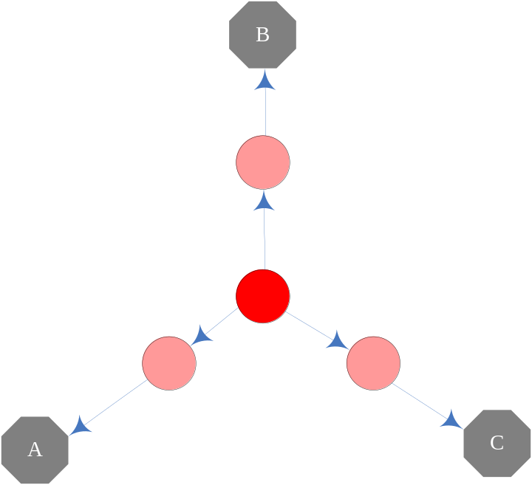

More in the paper…
Generalization to group proximity
  Definitions; Fast solutions
  ‘How close between/from CEOs and/to Accountants?’
More applications
  Dir-CePS, attributed-graphs
...
CePS
Common
descendant
Common
ancestor
Descendant of B; & Common
ancestor of A and C

Slide 42
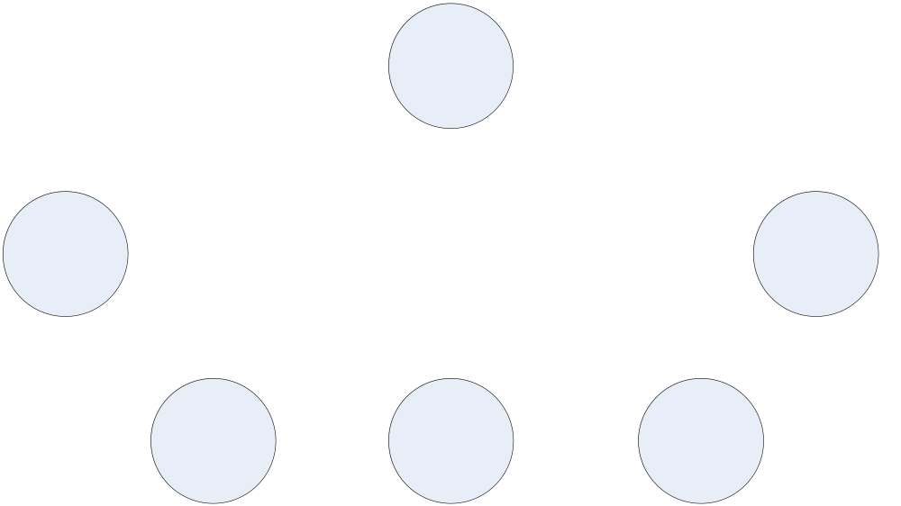



Cupid uses arrows, so does graph mining!
Thank you!
www.cs.cmu.edu/~htong

Slide 43
Back-up foils

Slide 44
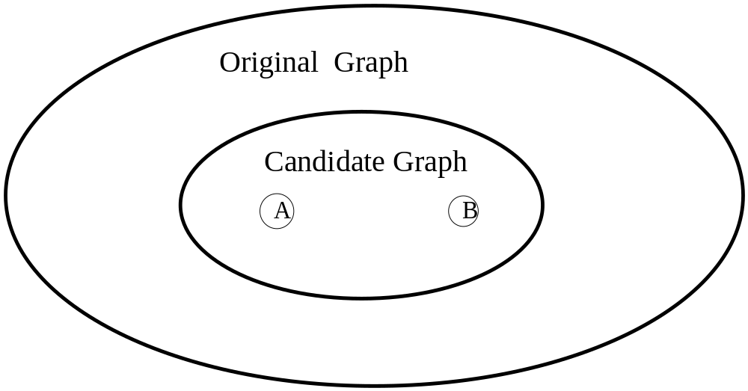
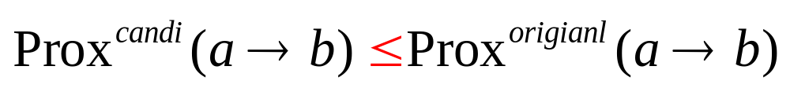
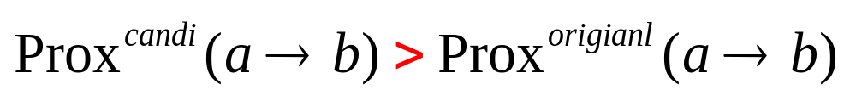
DAP: Size Bias [Koren+]
We want:
Actually:
Solution: degree preserving!

Slide 45
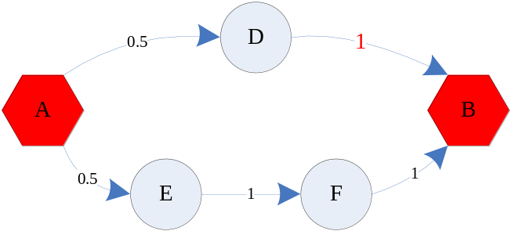
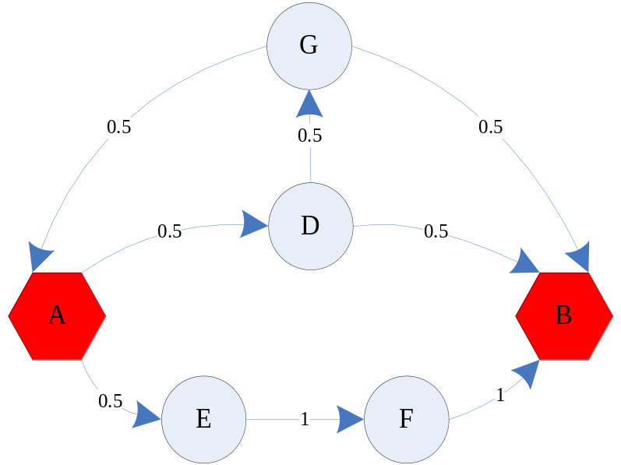
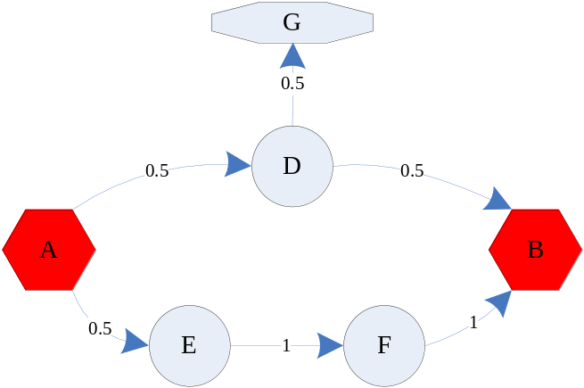
Practical Modifications: Degree-Preserving
Original graph:
Prox(a->b)=0.875
Prox(a->b)=1
A->D->B
A->E->F->B
A->D->G->B
Paths (A->B):
Prox(a->b)=0.75

Slide 46
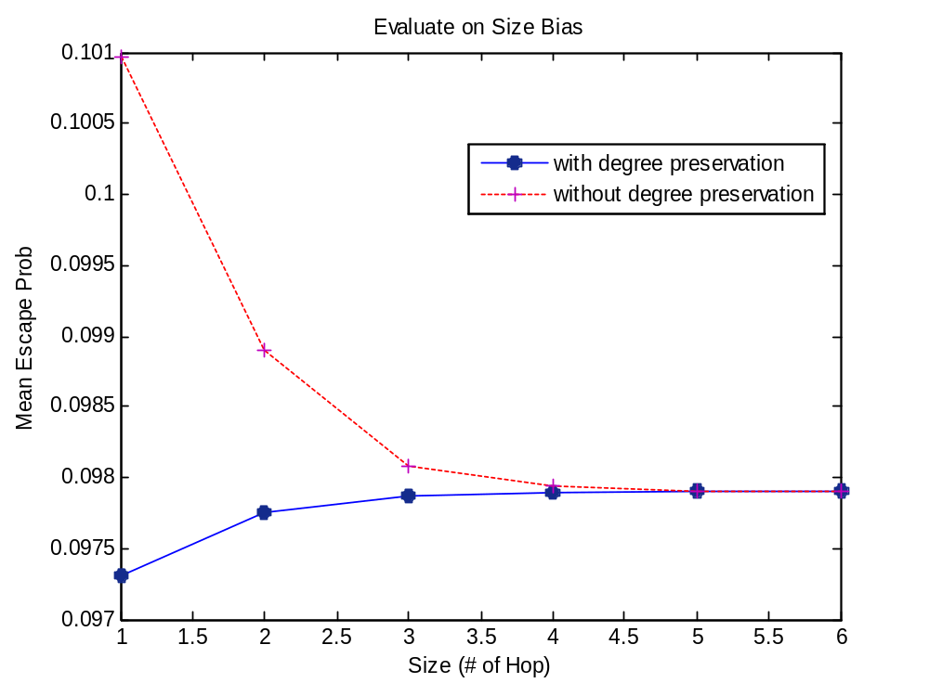
Practical Modifications: Degree-Preserving
Proximity
Size of Graph

Slide 47
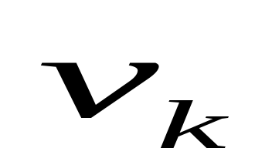
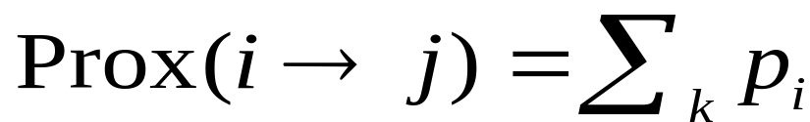
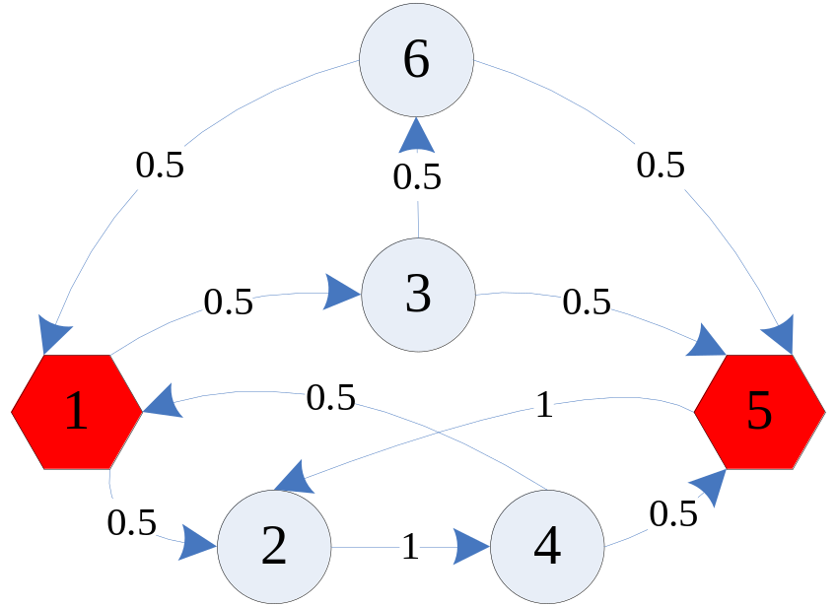
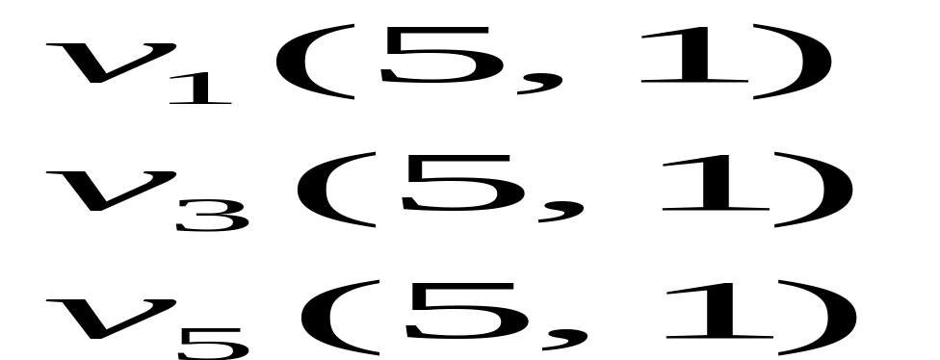
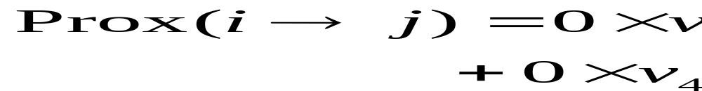
Solving DAP: [Doyle+]
Key quantity:
  Pr (RW starting at k, will visit j before i)
Q: How to solve ?

Slide 48
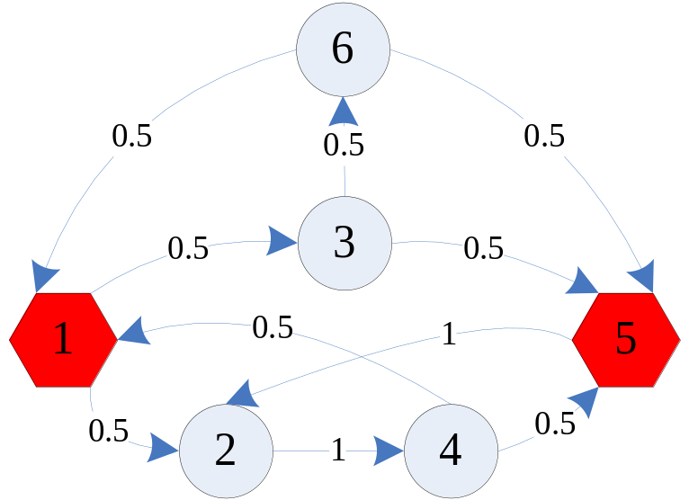
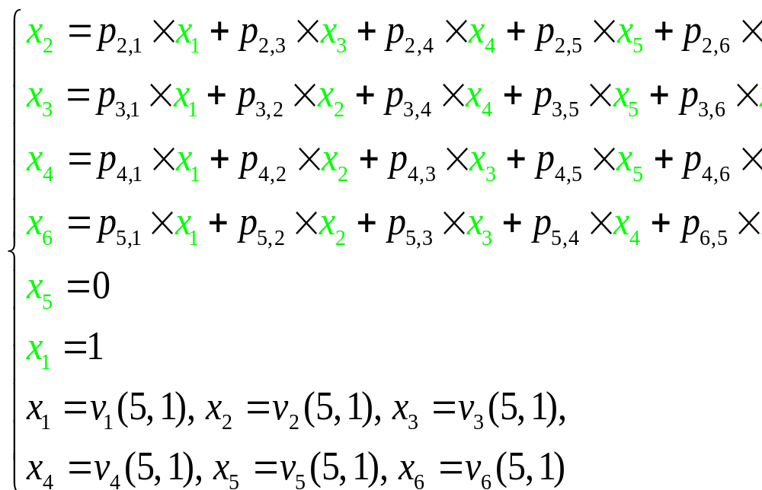
Solving [Doyle+]
Setup a linear system
Harmonic
property
Boundary
condition

Slide 49
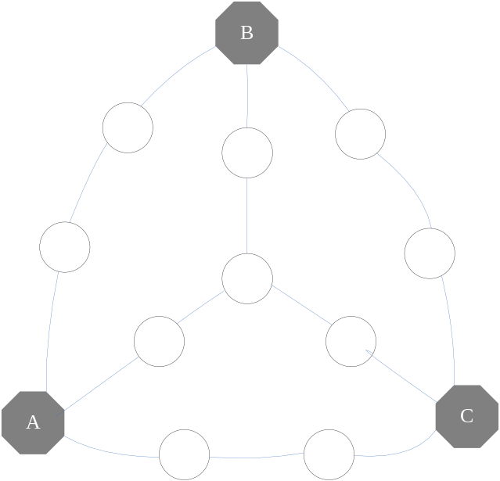
Effectiveness: CePS
CePS
Original Graph
Black: query nodes

Slide 50
From CePS to
Dir-CePS
Common
descendant
Common
ancestor
Descendant of B; &
Common ancestor of A and C

